Slide 1
DSA Project Thai License Random Generate Plates
Pongraphe Kangsanarak
st122601

Slide 2
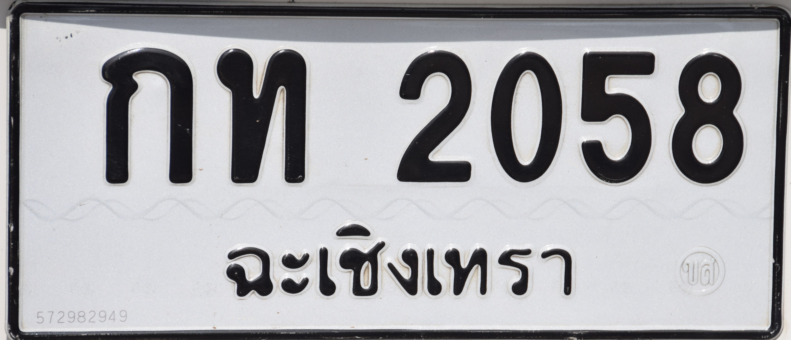
Introduction
The aim of the project is to demonstrate and compare algorithms between Binary Search Tree and Linked list.
The program feature:
Able to add a plate into the list
Search Individual plate in the list
Remove specific plate in the list
Display all plates

Slide 3
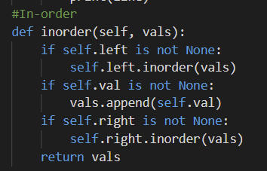
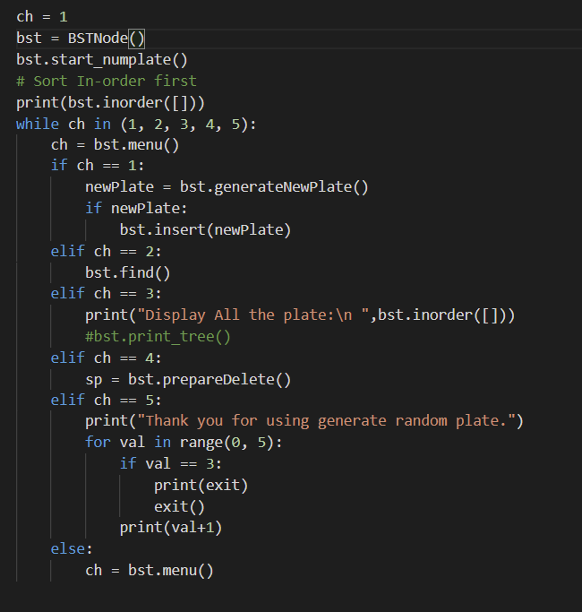
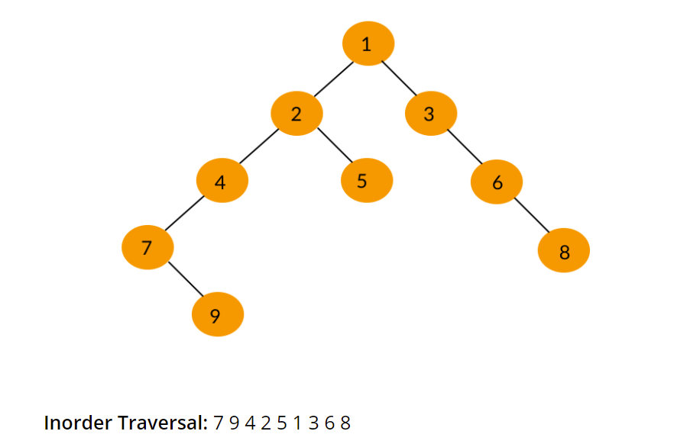
Menu

Slide 4
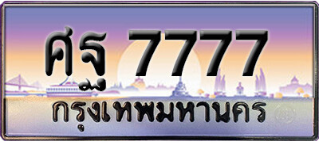
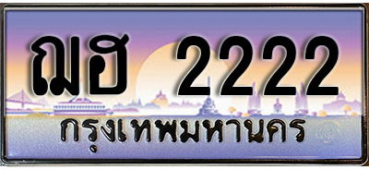
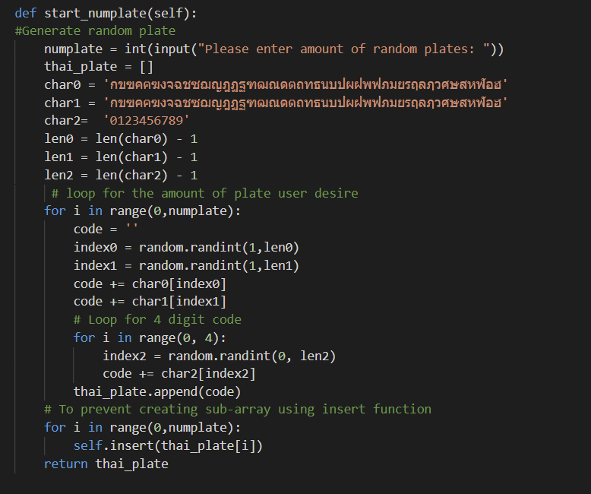
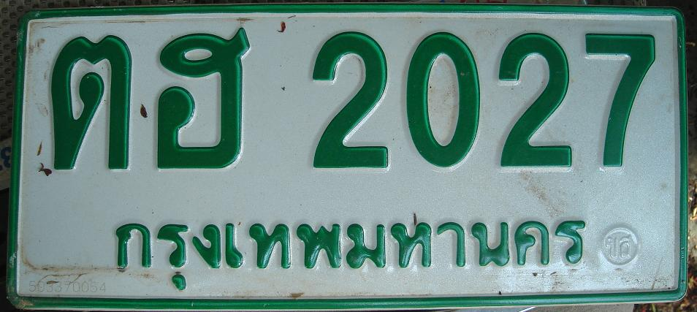

Generate Random Plates
Result: 5 Random plates

Slide 5
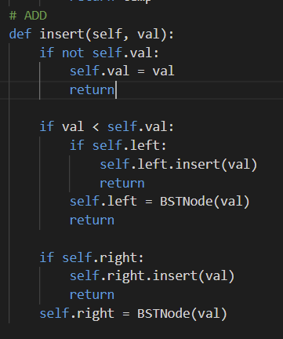
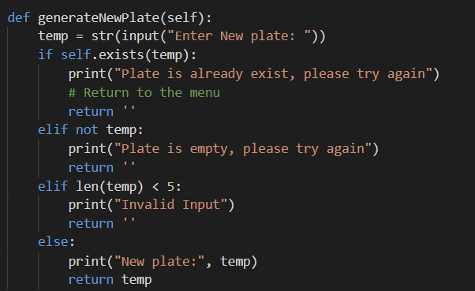
Add Plates BST

Slide 6
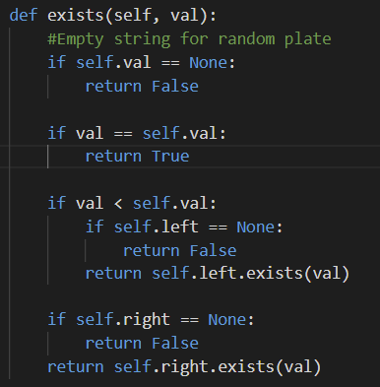
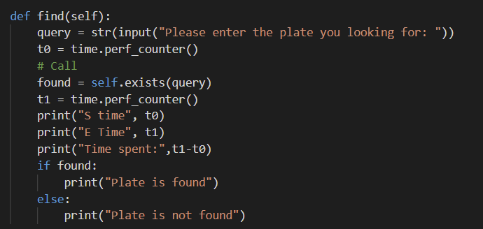
Search Plates BST

Slide 7

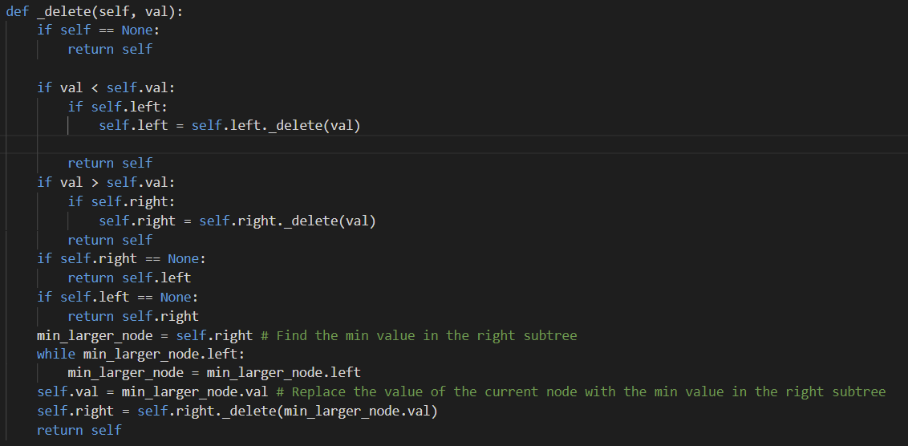
Remove Plates BST

Slide 8
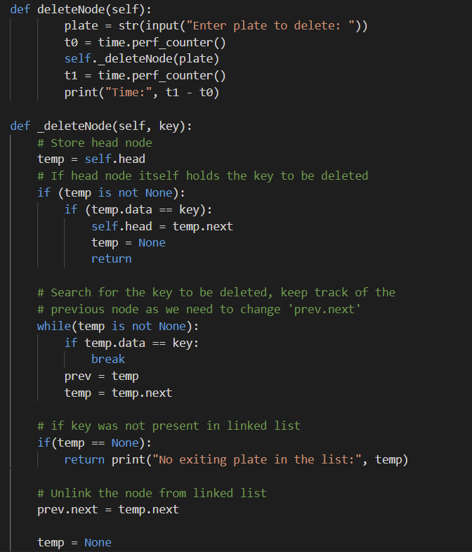
Remove Plates Linked List

Slide 9
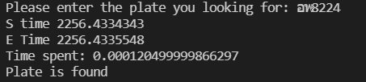

Task: Time Comparison
['ฑซ0667', 'ณย3191', 'ตฒ1679', 'ตฤ9650', 'ธด9713', 'พบ8733', 'รอ1739', 'อพ8224']
BST
Time complexity: O(logn)
Linked list
Time complexity: O(n)

Slide 10
Possible Future work/ Limitation
Future work
Add owner’s detail of the plates
Calculate the time user want the plate number
Do Hash table to sort the table.
Limitation
Need to be correct input.
Only one input at a time. Can not put in a list of plates.

